Slide 1
Food Delivery
By Group 4
Id | Name
2491361 | Kulkarni Sampada Sunilrao
2490795 | Bolleddulla Karthik Babu
2491196 | Indrayudh Dasgupta
2487464 | Mittapalli Sahithi Priya
2491169 | Perike Pavan Kumar
2490872 | Aishwarya Walmik Dhumane
2490188 | Gunthapalli Lochan Aravind Akash
2489203 | Kamaljyothi Battula
2490669 | N Aswini
2490615 | Prateek Prashant Awate

Slide 2
Abstract
Foodie Time is a restaurant chain that delivers food items of different cuisines at affordable prices. It was established in 2014.It had been serving fine all these years; however, the business analysts noticed a decline in sales since 2016. They found out that online ordering of food items with companies, such as Swiggy and Foodpanda are gaining more profits by eliminating middlemen from the equation. As a result, the team decided to hire a Full Stack developer to develop an online food delivery web application with a rich and user-friendly interface. You are hired as the Full Stack Java developer and are asked to develop the web application. The management team has provided you with the requirements and their business model so that you can easily arrange different components of the application.

Slide 3
Project Objective
Create a dynamic and responsive Angular UI/UX food delivery application for online ordering of food items of different cuisines from a restaurant.

Slide 4
Scope and Purpose
To provide a bug-free Online Food Delivery system to Users as well as Admin.
The main objective is here to provide a nice and secure platform for Ordering Food.
To maintain the records of Product, Category available into the system.

Slide 5
Tools and Technologies
Front End-
Angular
Back End-
JSON

Slide 6
Functional Requirements and Modules
Admin User: The admin user should be able to:
Login to portal
Add or remove cuisines to or from the application to build a rich product line
End User: The end user must be able to:
Register to the application
Sign into the application to maintain the record of activities
Search for food items based on the search keyword
Apply filters and sort results based on different cuisines to get the best deals
Add all the selected food items to a cart and customize the purchase at the end
Perform a seamless payment process

Slide 7
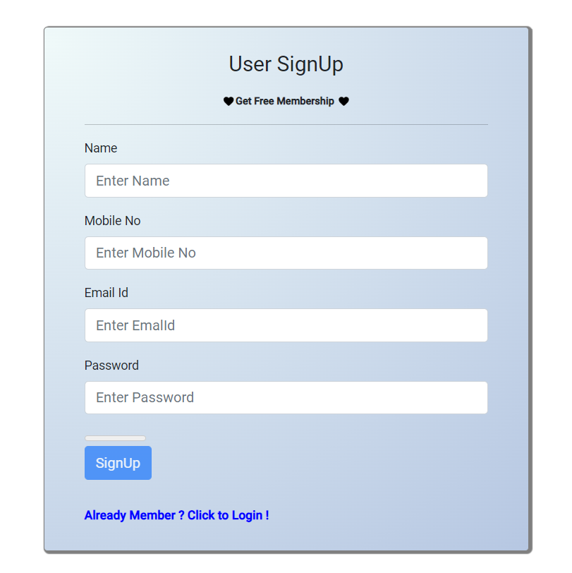
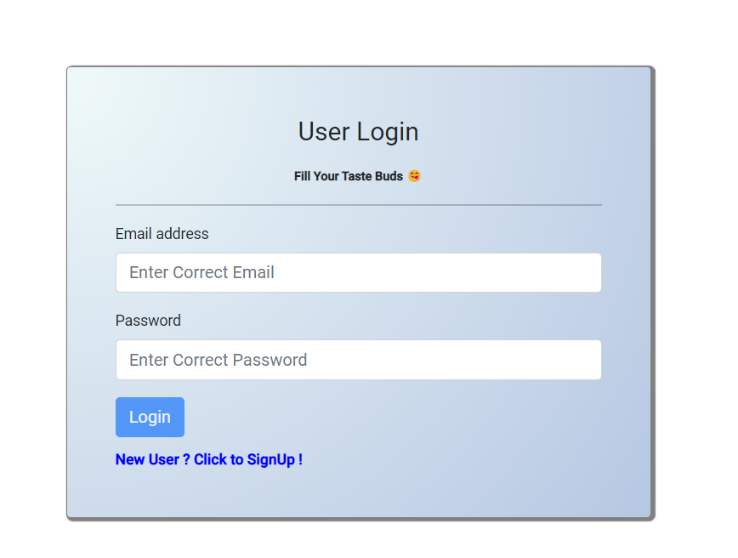
User Interface Page Screenshots

Slide 8
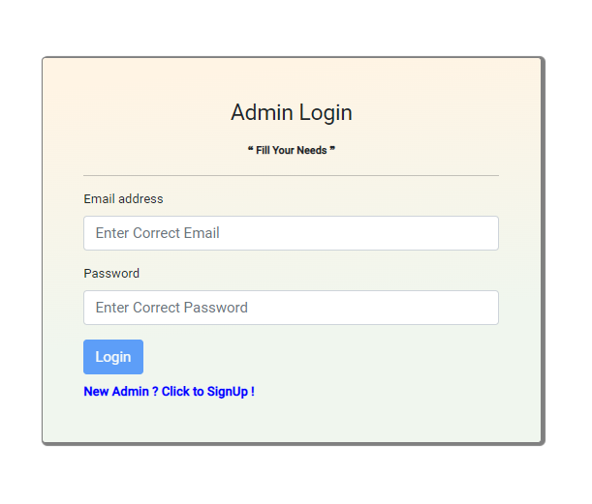
Admin Interface Page Screenshots

Slide 9
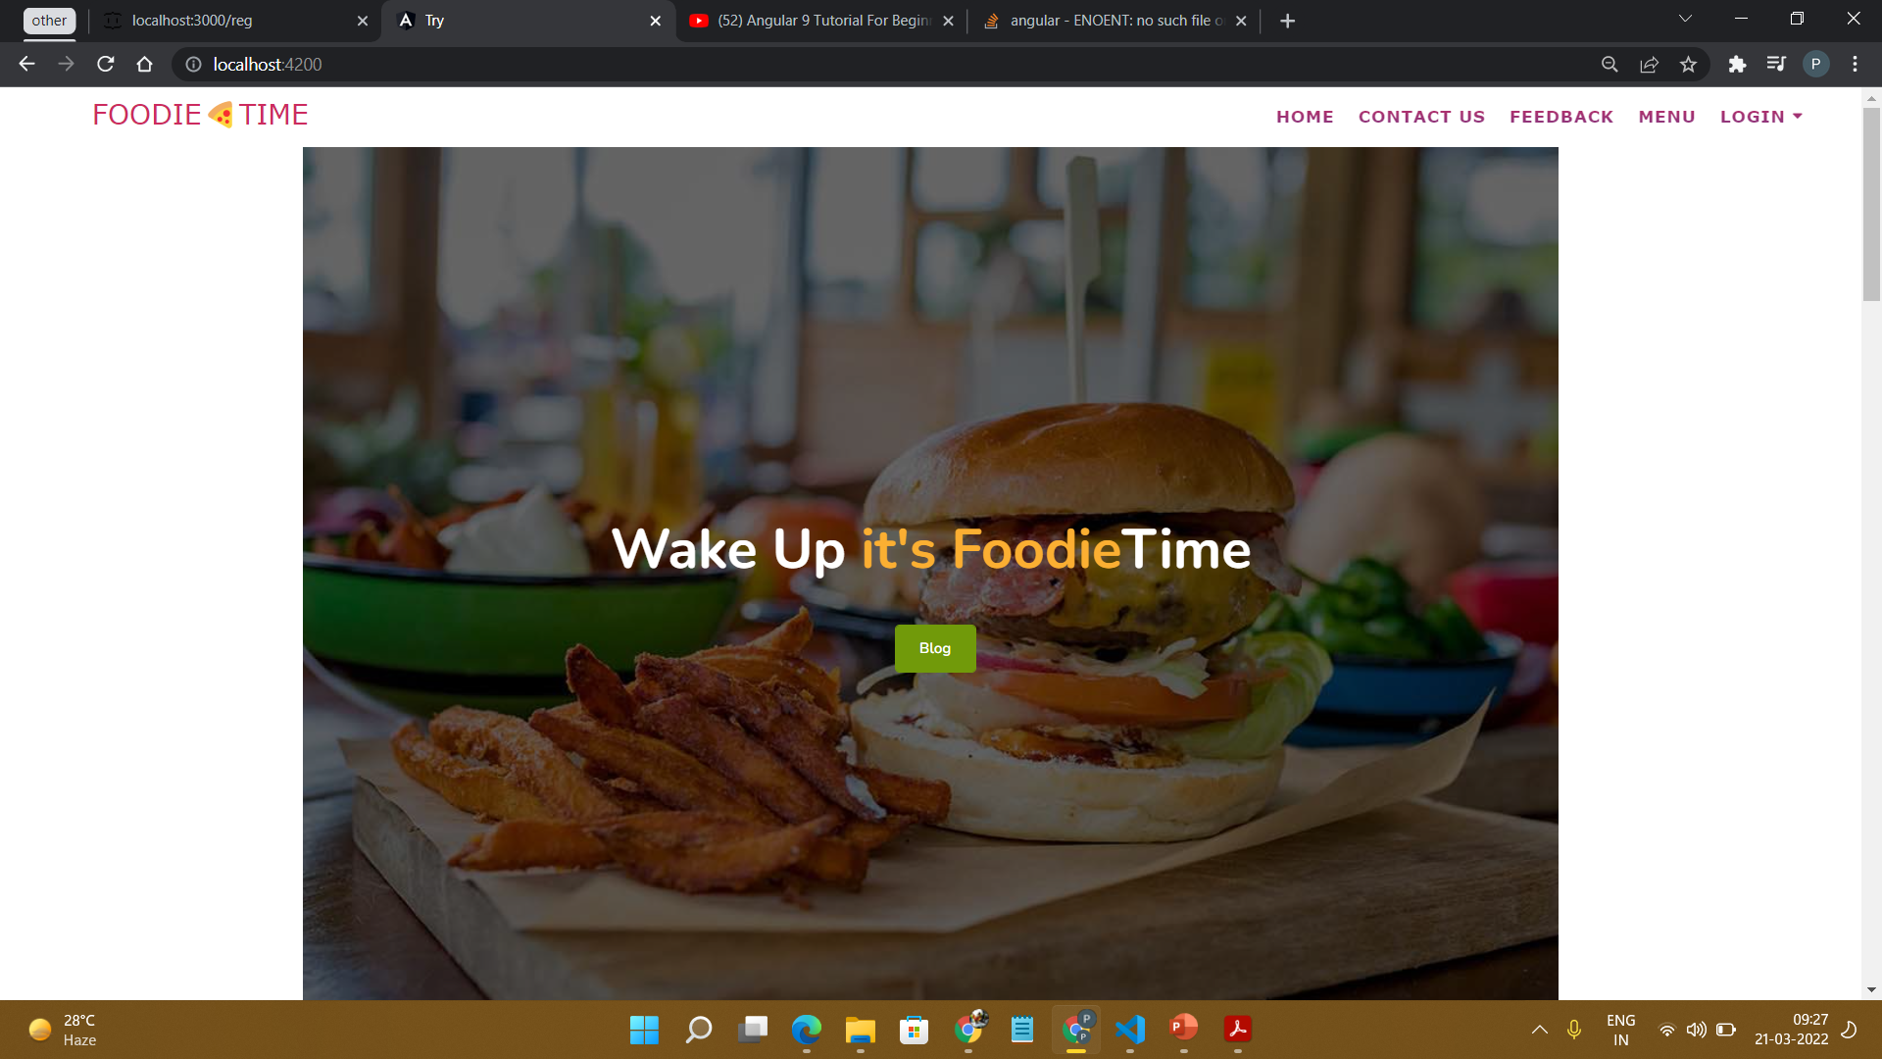
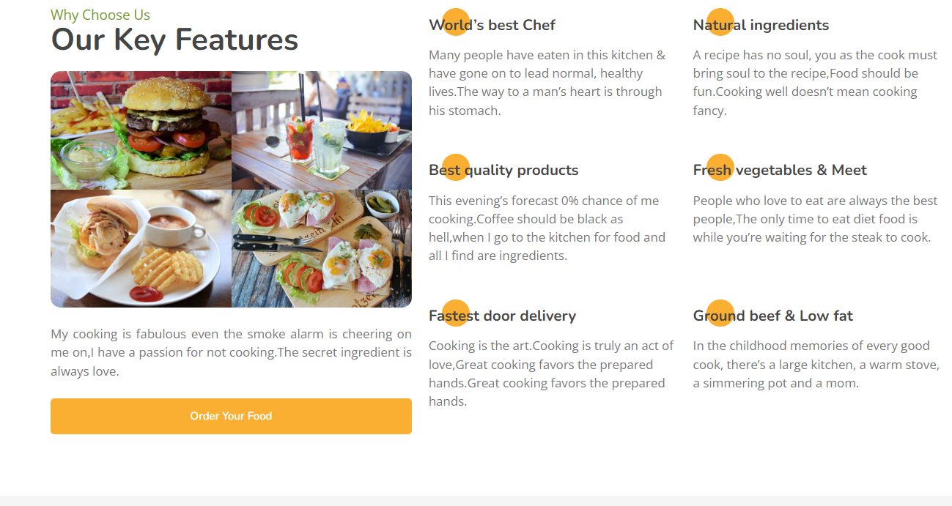
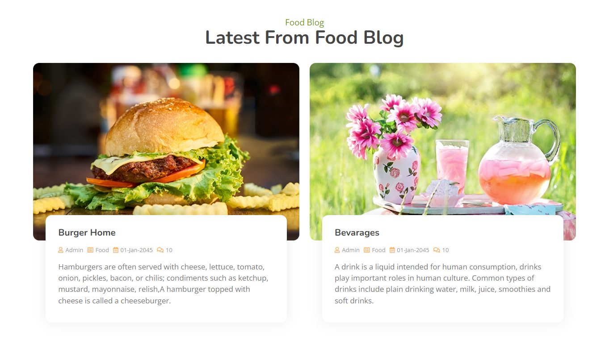
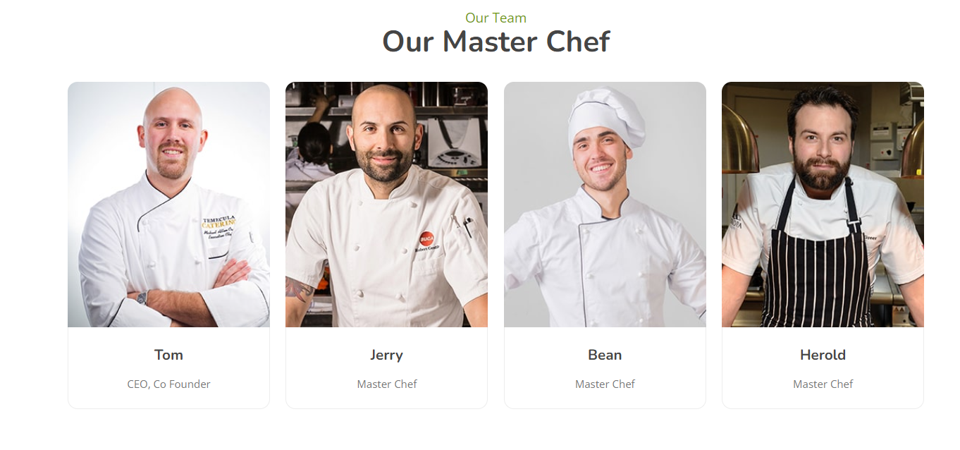
Home Page

Slide 10
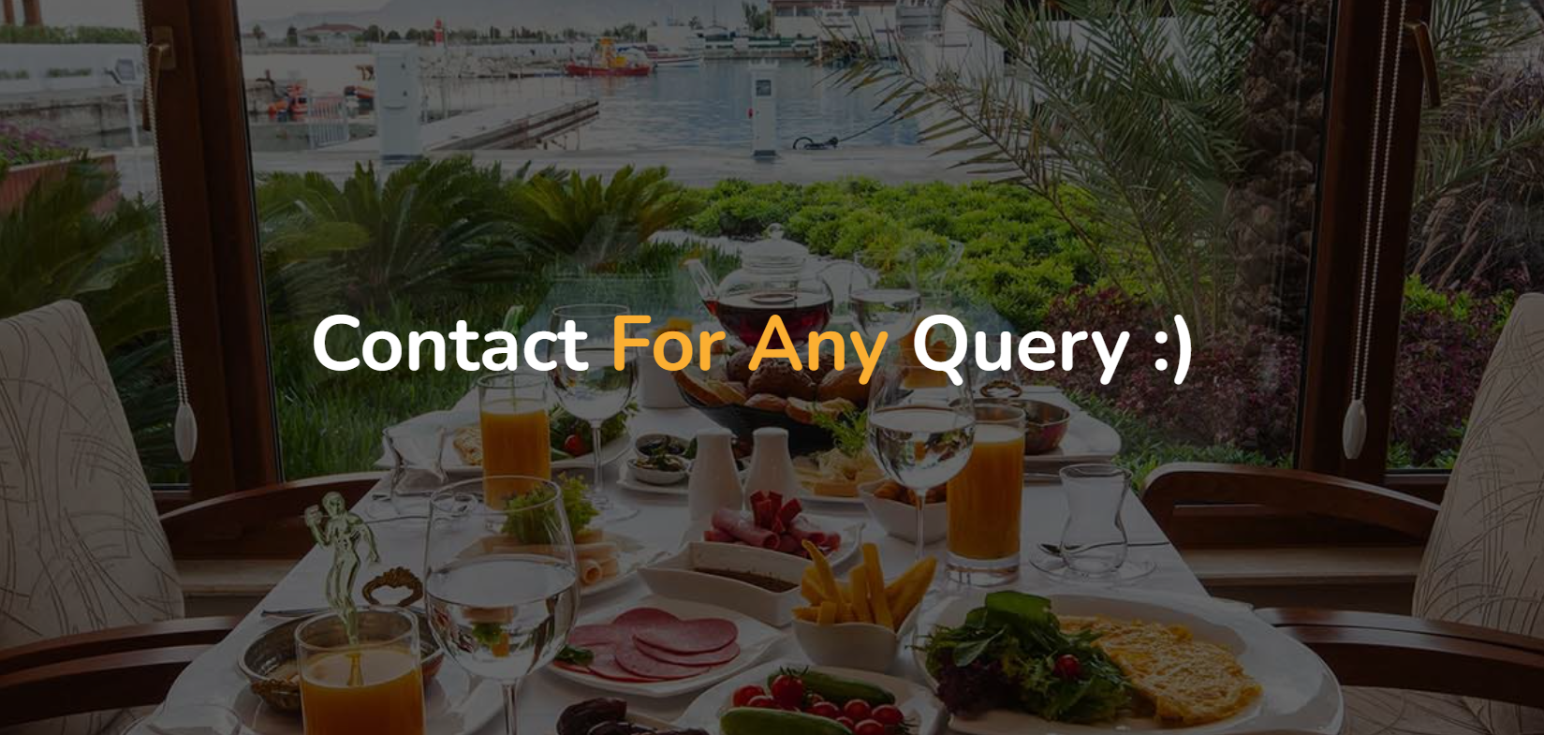
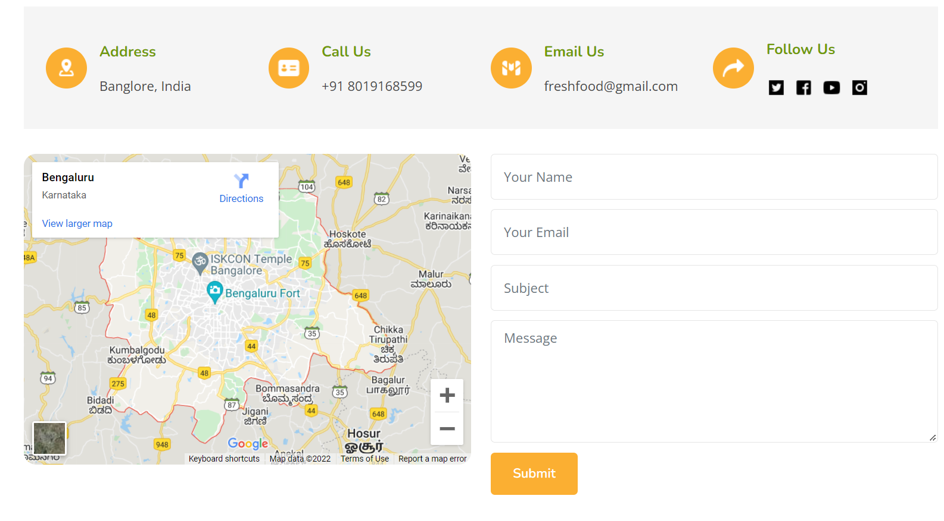
Contact Page

Slide 11
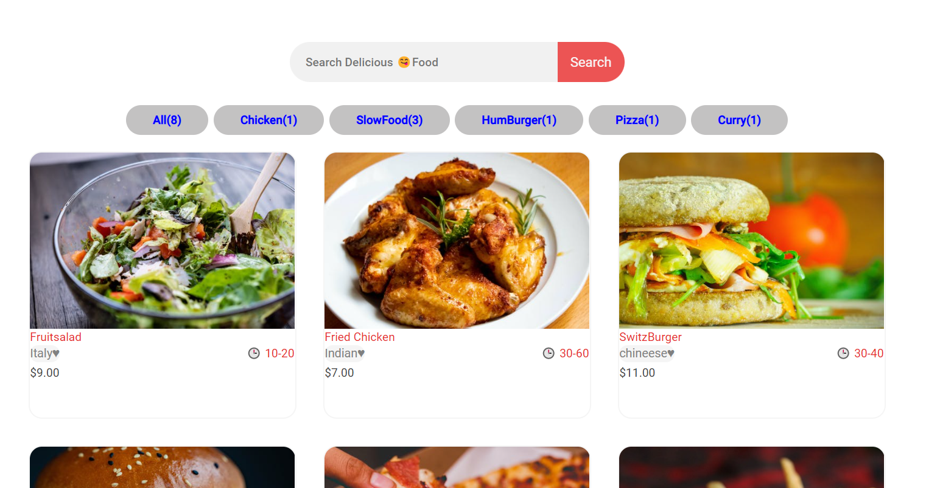
Menu Page

Slide 12
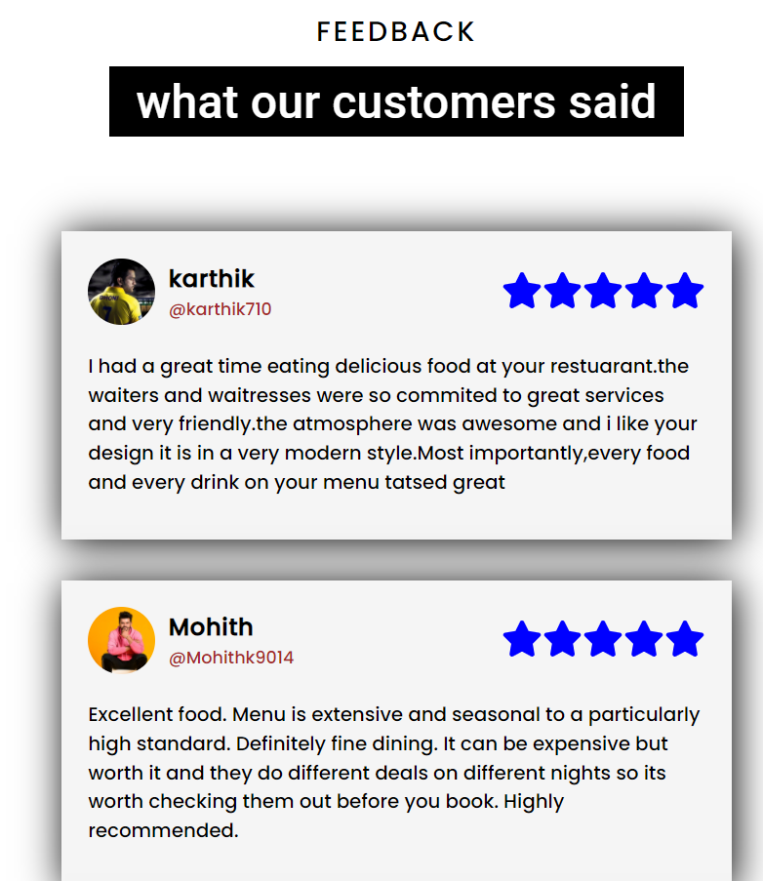
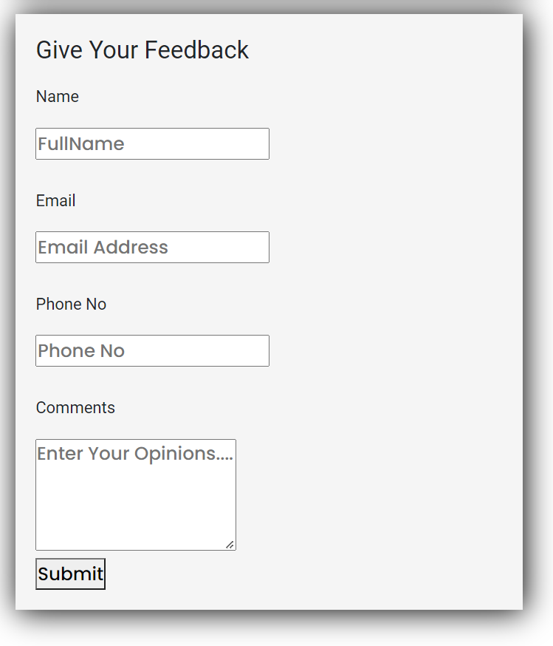
Feedback Page

Slide 13
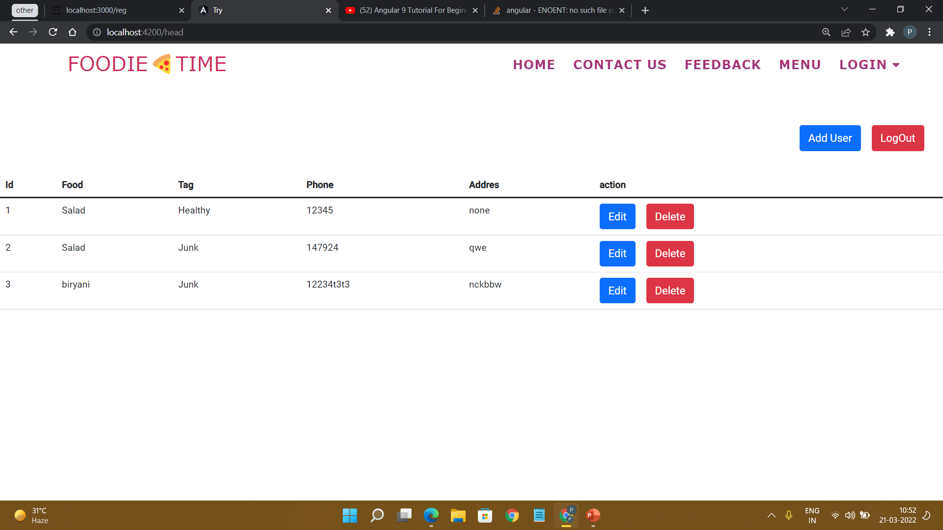
Admin Adding Food Items

Slide 14
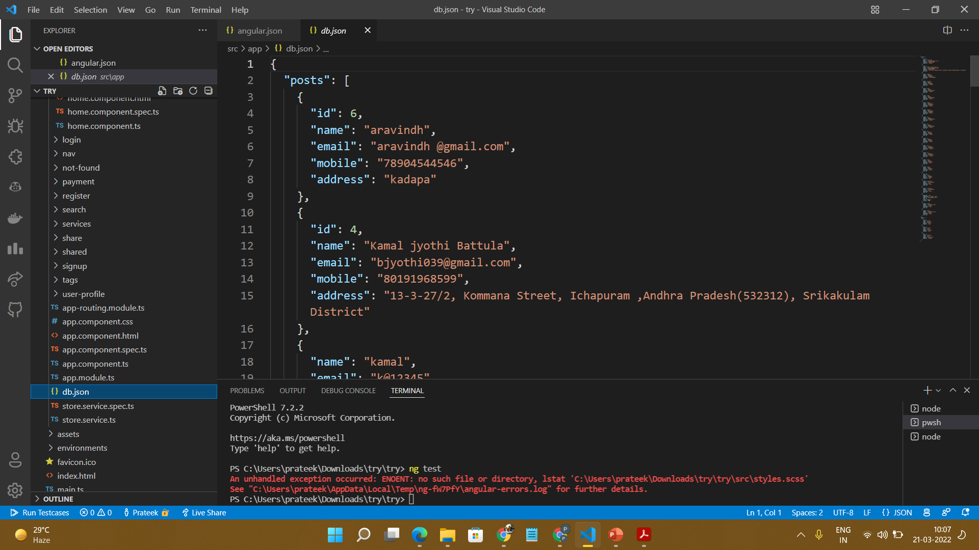
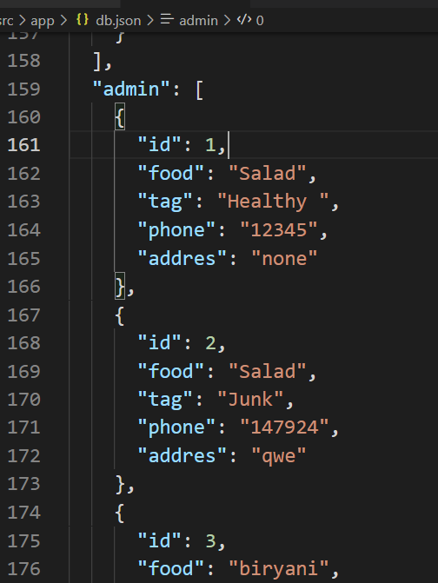
Back End Development

Slide 15
THANK YOU

